Slide 1
RMI (Remote Method Invocation)

Slide 2
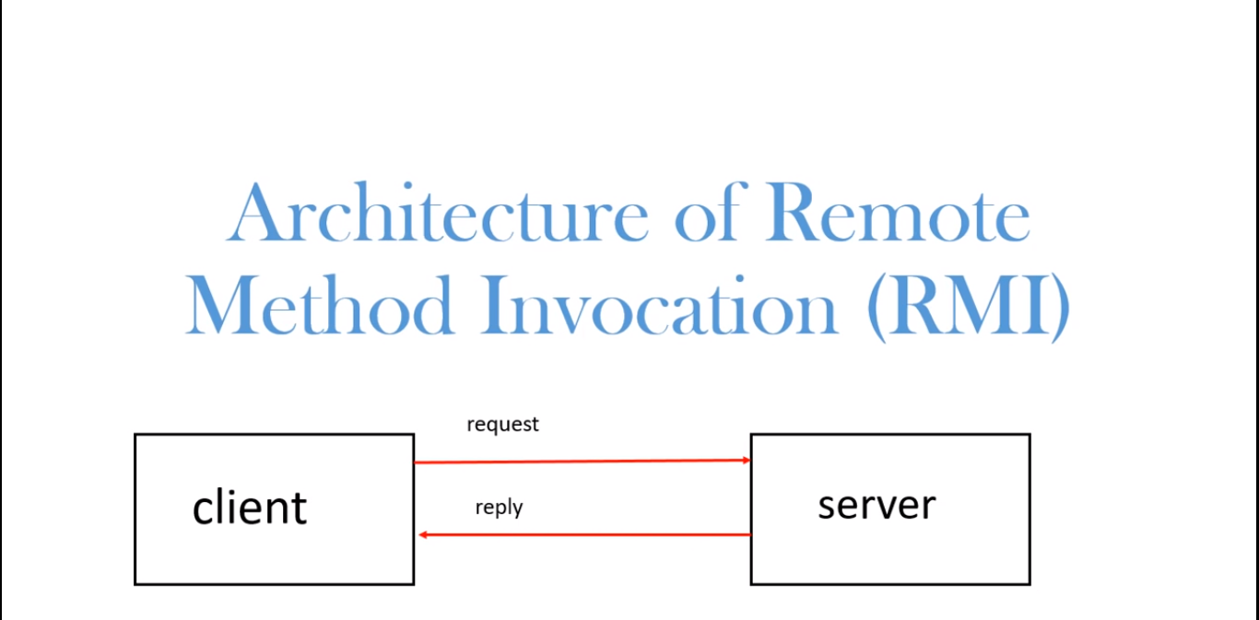

Slide 3
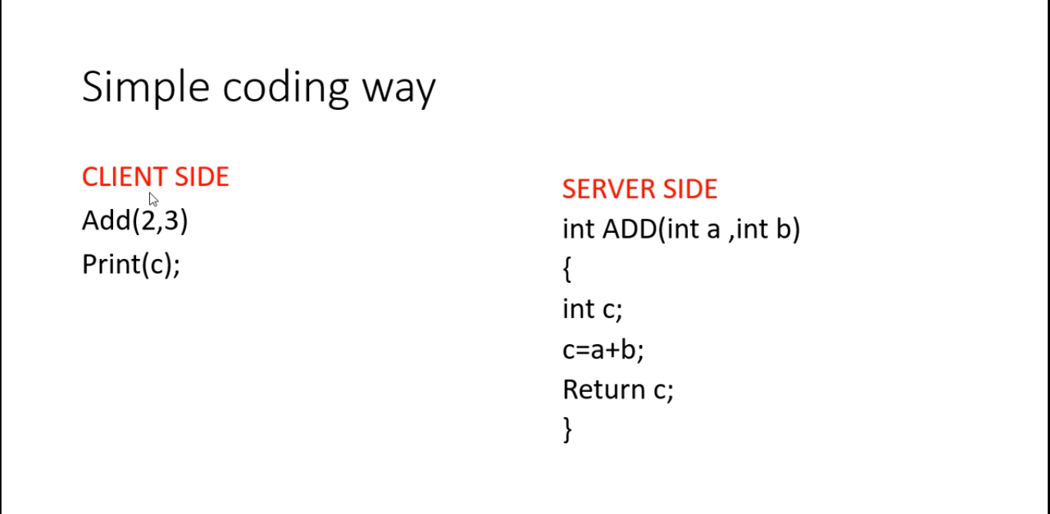

Slide 4
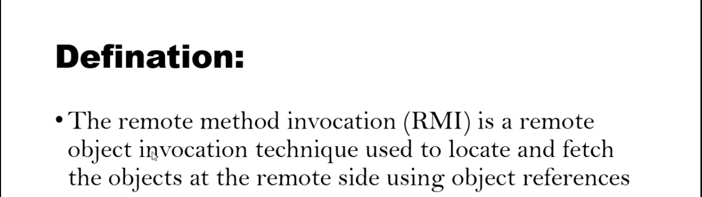

Slide 5
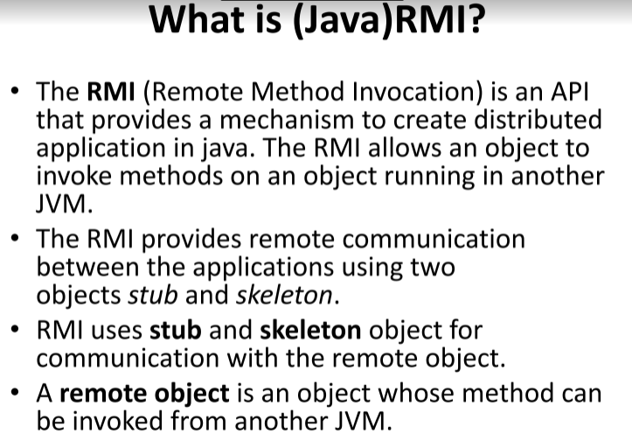

Slide 6
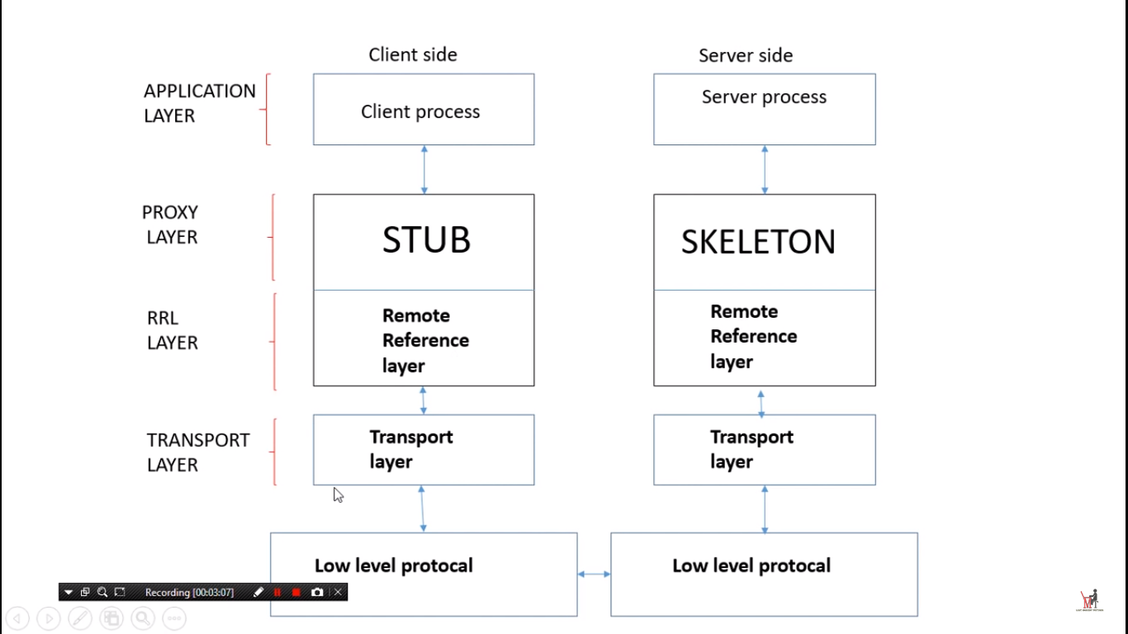

Slide 7
stub
The stub is an object, acts as a gateway for the client side. All the outgoing requests are routed through it. It resides at the client side and represents the remote object. When the caller invokes method on the stub object, it does the following tasks:
It initiates a connection with remote Virtual Machine (JVM),
It writes and transmits (marshals) the parameters to the remote Virtual Machine (JVM),
It waits for the result
It reads (unmarshals) the return value or exception, and
It finally, returns the value to the caller.

Slide 8
skeleton
The skeleton is an object, acts as a gateway for the server side object. All the incoming requests are routed through it. When the skeleton receives the incoming request, it does the following tasks:
It reads the parameter for the remote method
It invokes the method on the actual remote object, and
It writes and transmits (marshals) the result to the caller.

Slide 9
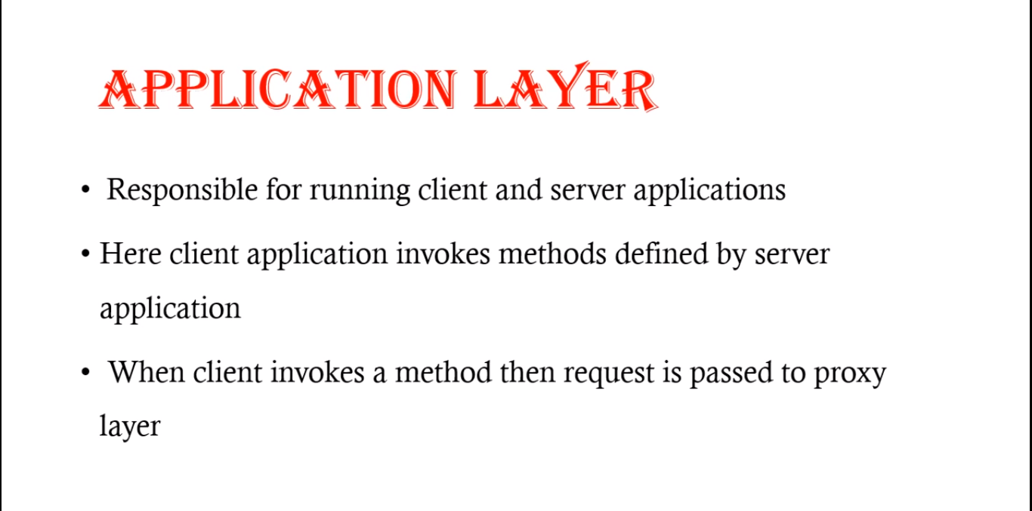

Slide 10
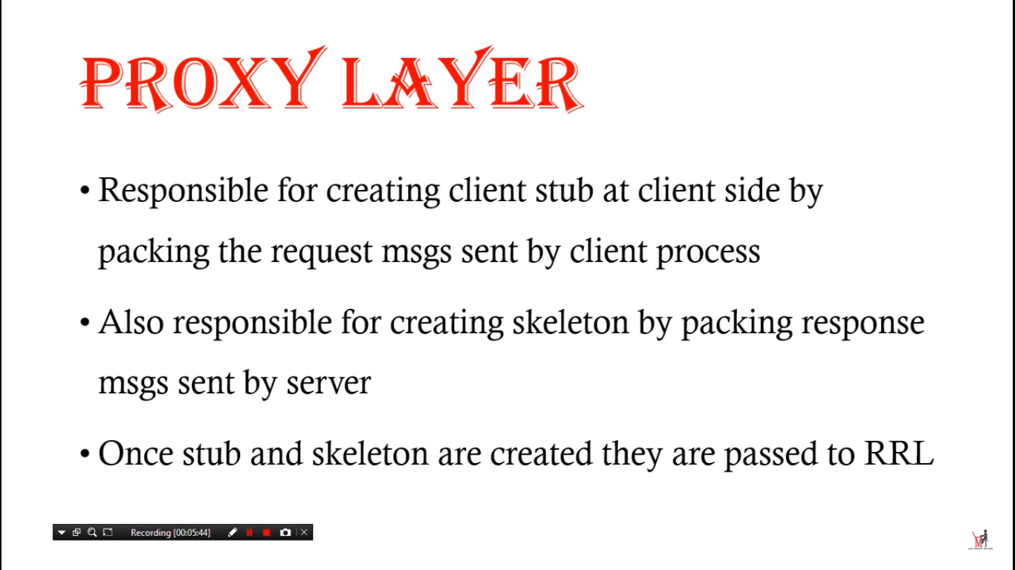

Slide 11
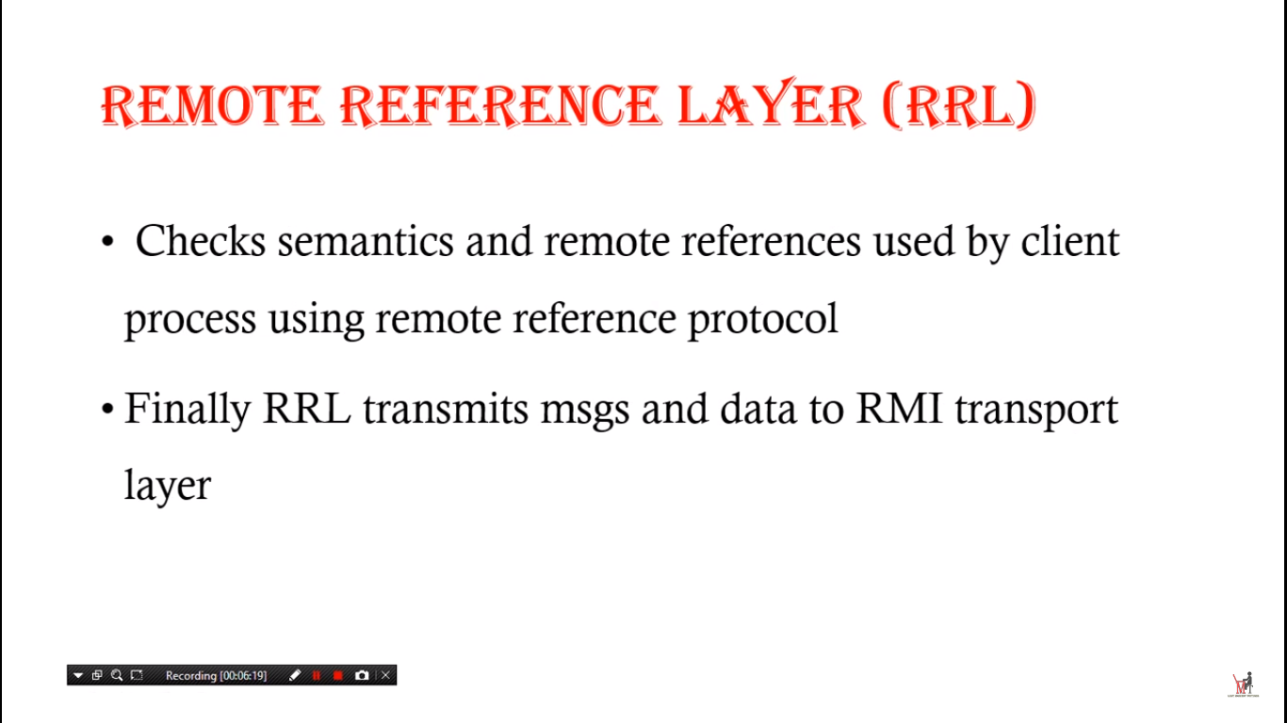

Slide 12
